Slide 1
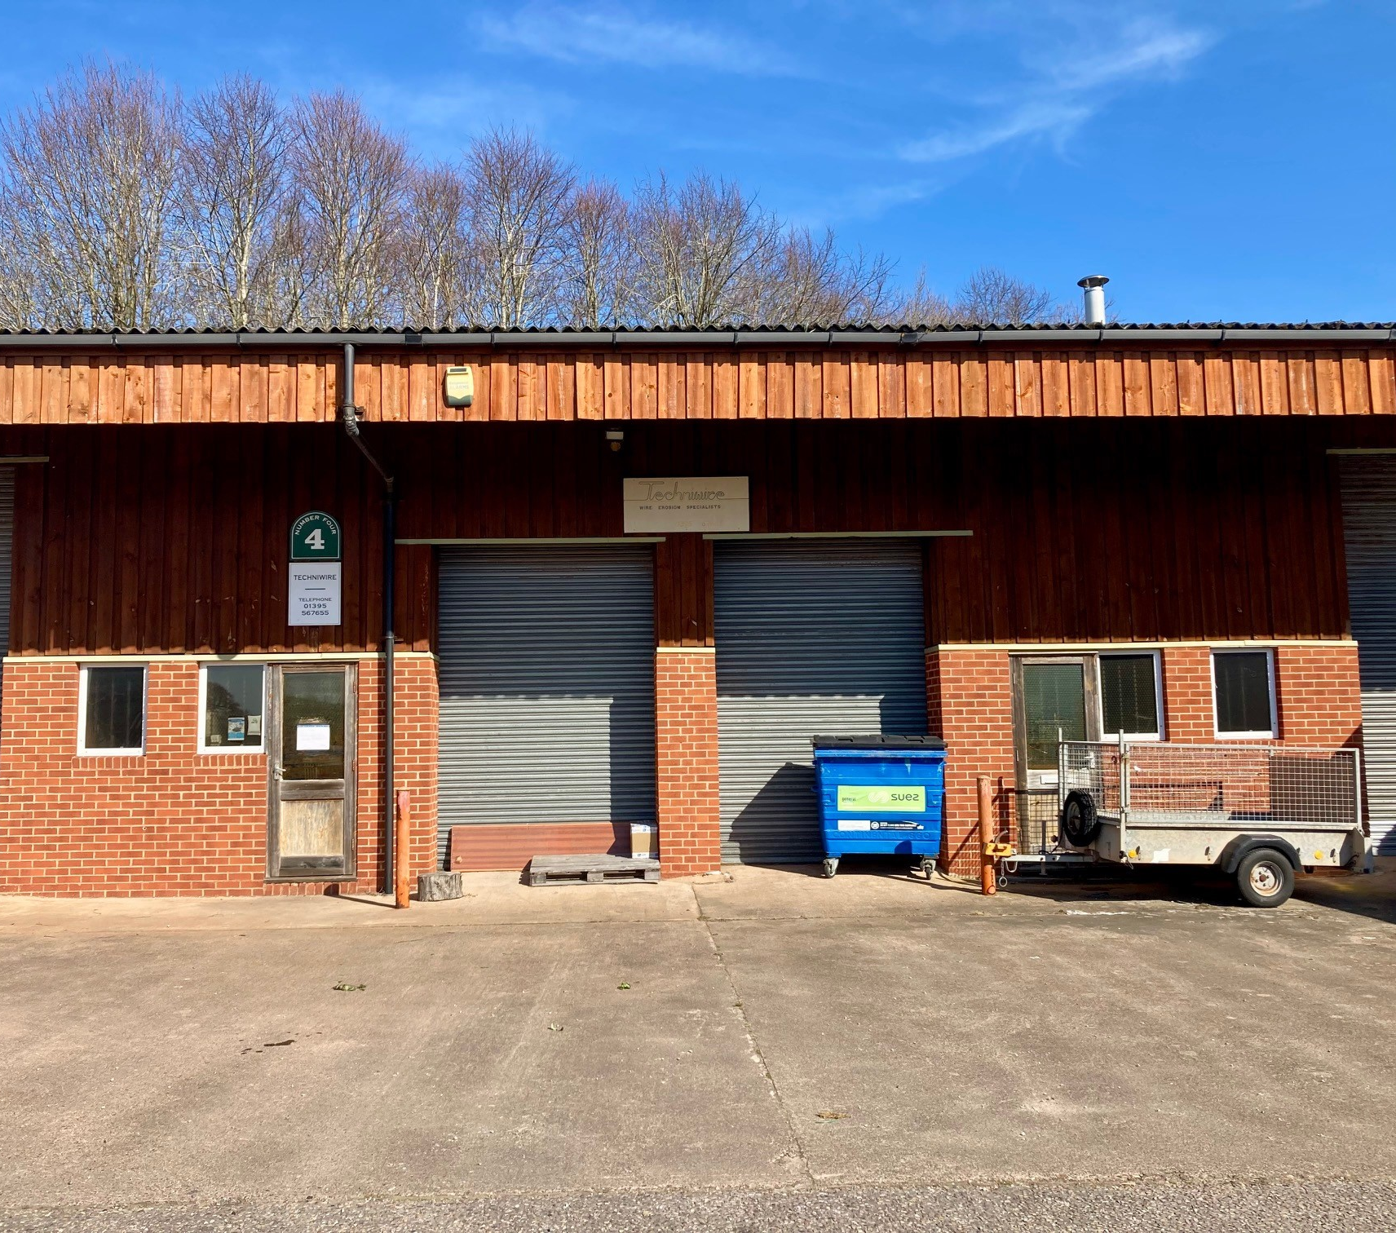
COMMERCIAL UNIT
1226 SQ FT ( 114 SQ M)
Modern light industrial unit
Established Industrial estate
Suitable for a variety of uses, subject to consents
£8,950 per annum exclusive
UNIT 4, THE OLD SAWMILLS
Hawkerland Road, Colaton Raleigh, Sidmouth, EX10 0HP

Slide 2
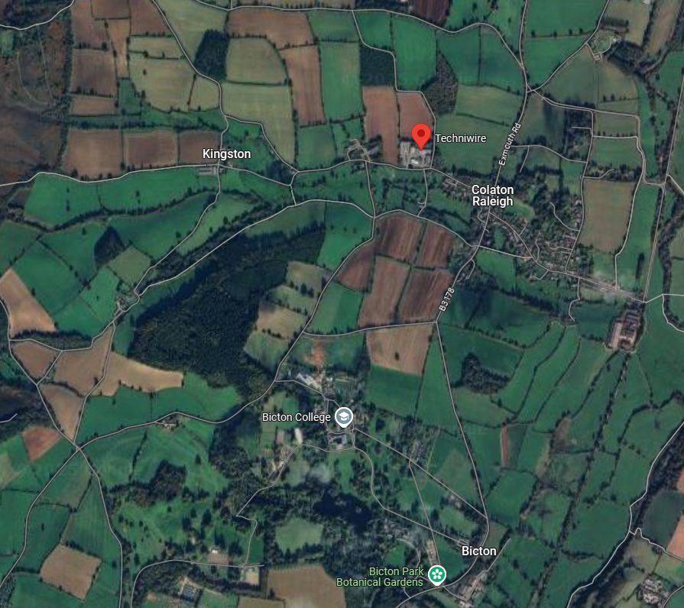
DESCRIPTION
A modern purpose built light industrial unit of clearspan design with insulated walls and mono pitched roof. The unit has the benefit of two steel roller shutter doors each with a width of 7ft 3” (2.15m) and a height of 10’ 8” (3.27 m). The unit has a maximum eaves height of 16’ 11” (5.16m) reducing to 11’ 9” (3.59m) at the rear.
ACCOMODATION
The accommodation is arranged over one floor and includes two personal front entrance doors, two emergency exit doors and a washroom/wc on each side of the unit.
Gross internal Area: | 1226 sq ft | (114 sq m)
SERVICES
Mains 3 Phase electricity, water and drainage.
BUSINESS RATES
Ratable Value 2023 List: £7,300
(100% Small Business Rates Relief may be available to qualifying businesses in respect of this unit but for further information, please contact the local billing authority (East Devon District Council).
RENT
£8,950 per annum exclusive of outgoings.
TERMS
The unit is available by way of a new 6- year lease on full repairing terms. The Landlord is to provide buildings insurance with the premium being recovered from the Tenant as additional rent.
ENERGY PERFORMANCE CERTIFICATE (EPC)
EPC Rating - C
LOCATION
Conveniently situated within an established industrial estate on the outskirts of the village of Colaton Raleigh, between the coastal towns of Exmouth and Sidmouth. Within 10 miles of the city of Exeter and the M5 Motorway Junctions 30 and 29.
VIEWING
Adrian Priest: 07469 855775 adrian.priest@clintondevon.com
Enquiries: 01395 443881 mail@clintondevon.com
Misrepresentation Act 1967 and Property Misdescriptions Act 1991 – “Clinton Devon Estates give notice that these particulars do not form, or form part of, any offer or contract. They are intended to give fair description of the property and whilst every effort has been made to ensure their accuracy this cannot be guaranteed. Any intending occupier/purchaser must therefore satisfy themselves by inspection or otherwise. Clinton Devon Estates does not make or give, and nor do any of its employees have any authority to make or give, any further representations or warranty whatsoever in relation to this property. All prices and rents quoted are net of VAT. January 2024
VAT
All figures within these particulars are subject to the addition of VAT at the statutory rate.
LEGAL COSTS
The parties are to be responsible for their own legal costs incurred in these transactions.

